Slide 1

Eye tracking
Filip Děchtěrenko

Slide 2

Why measure eye movements?
Eye movements and attention are connected

Slide 3
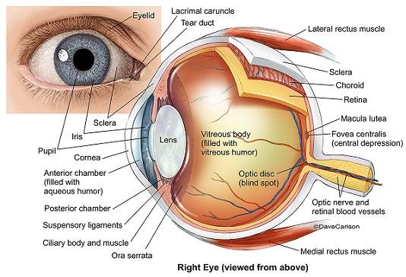
Human eye anatomy

Slide 4

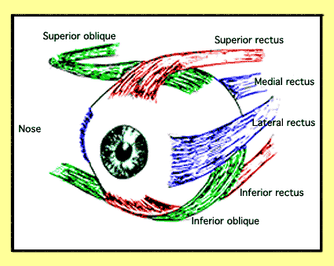
Type of eye movements
Muscules orient fovea to the location of the interest

Slide 5
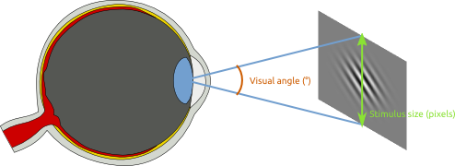
Visual angle
Eye movments are measured in visual angles

Slide 6
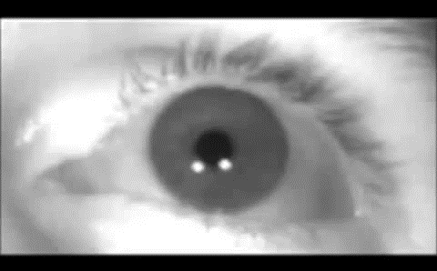
Saccades
Saccade
Fast eye movements (up to 900°/s), 200 ms planning, 20-200 ms execution
balistic trajectory (can’t be replanned during movement)
new information is not processed during saccades (trans-saccadic intergration)

Slide 7
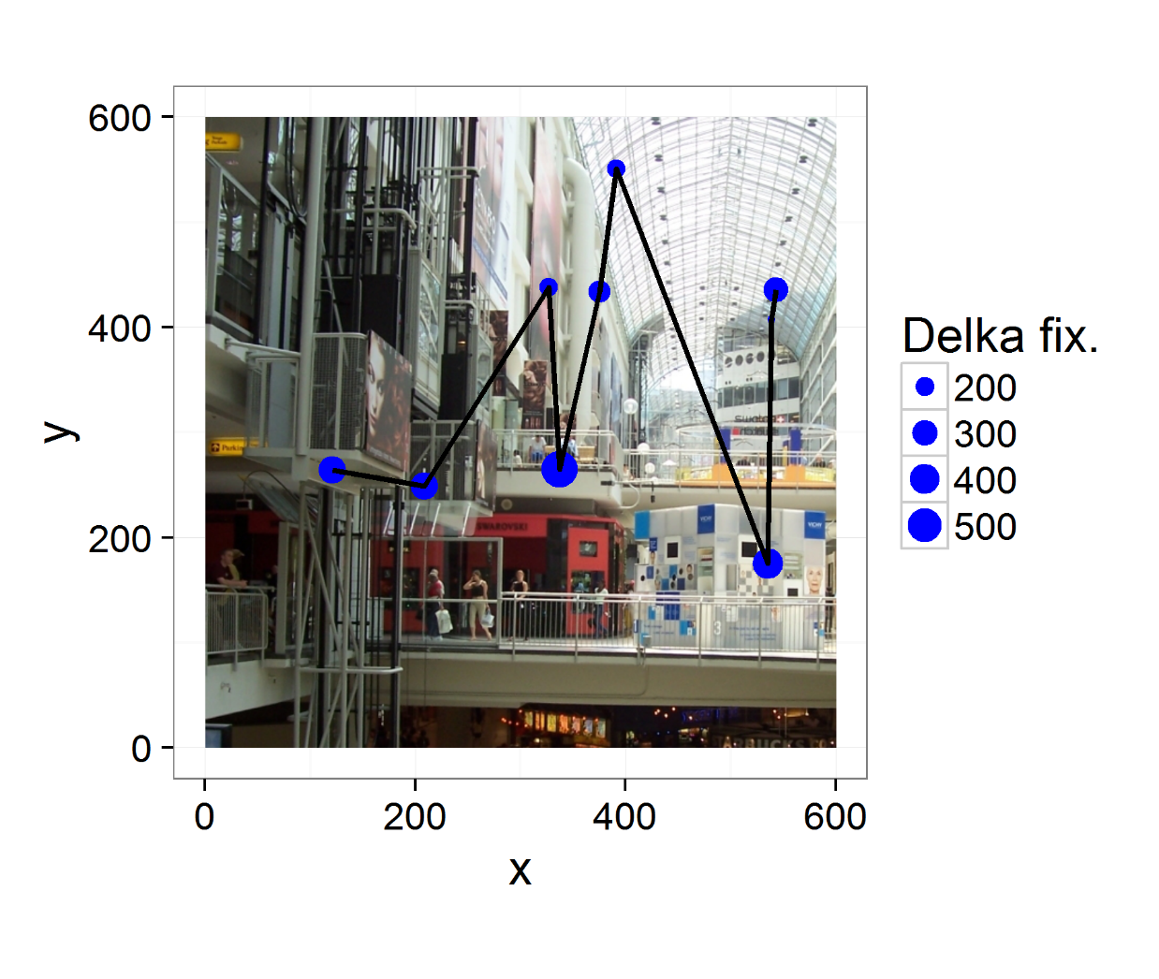
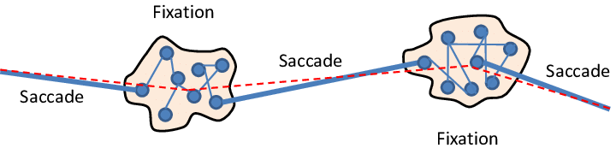
Fixations
saccades
„Intervals between saccades“
approx 200-300ms
fixation

Slide 8
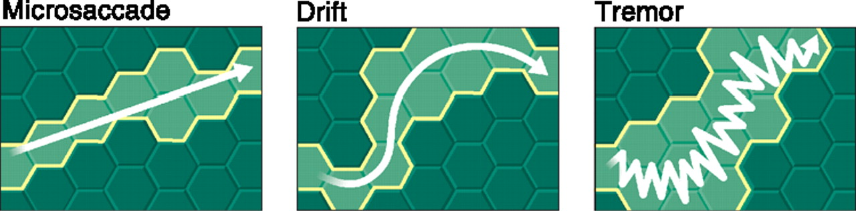
Smaller types of eye movements

Slide 9
How to find fixations and saccades?
Isn’t this a saccade?

Slide 10
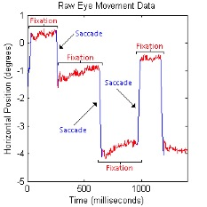
How to find fixations and saccades?
Dispersion based
Set threshold on dispersion of individual data samples
Samples farther than threshold are different fixations
Velocity bases
Compute sample to sample velocity and classify according to this threshold
Isn’t this a saccade?

Slide 11
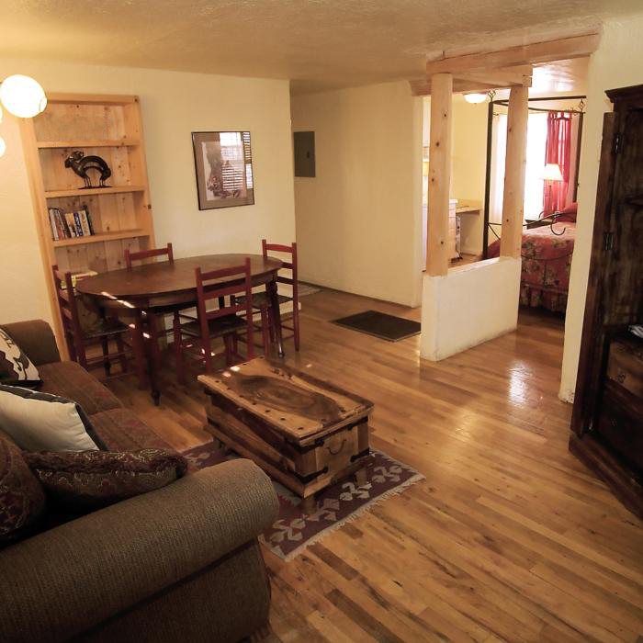

Static vs dynamic task

Slide 12
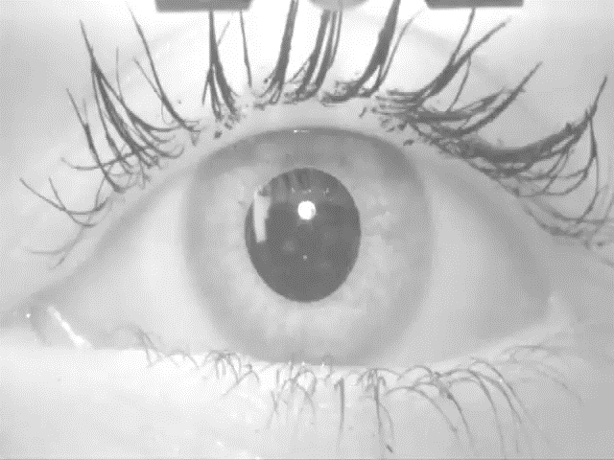
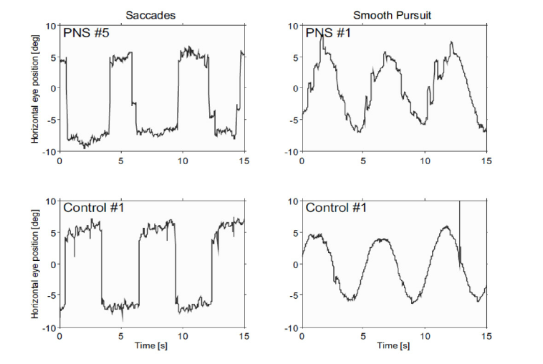
Smooth pursuit
Smooth movement of the eye
Difficult to detect

Slide 13
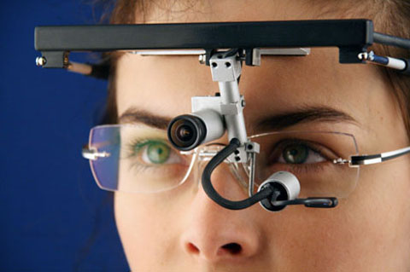
How to measure eye movements?

Slide 14
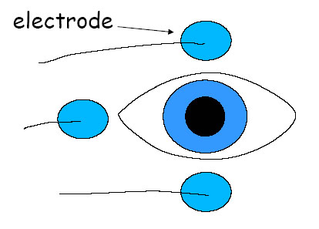
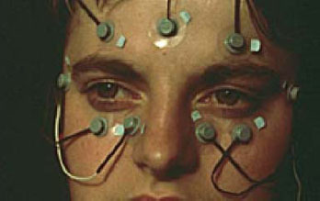
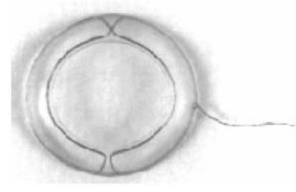
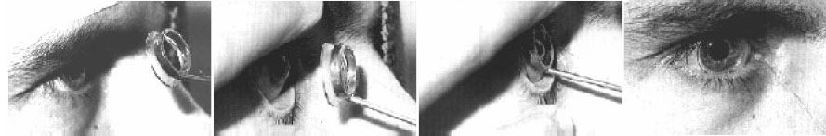
Types of eye trackers?
Electrooculogram
High temporal, low spatial accuracy
Scelar coils
High temporal, supreme spatial

Slide 15
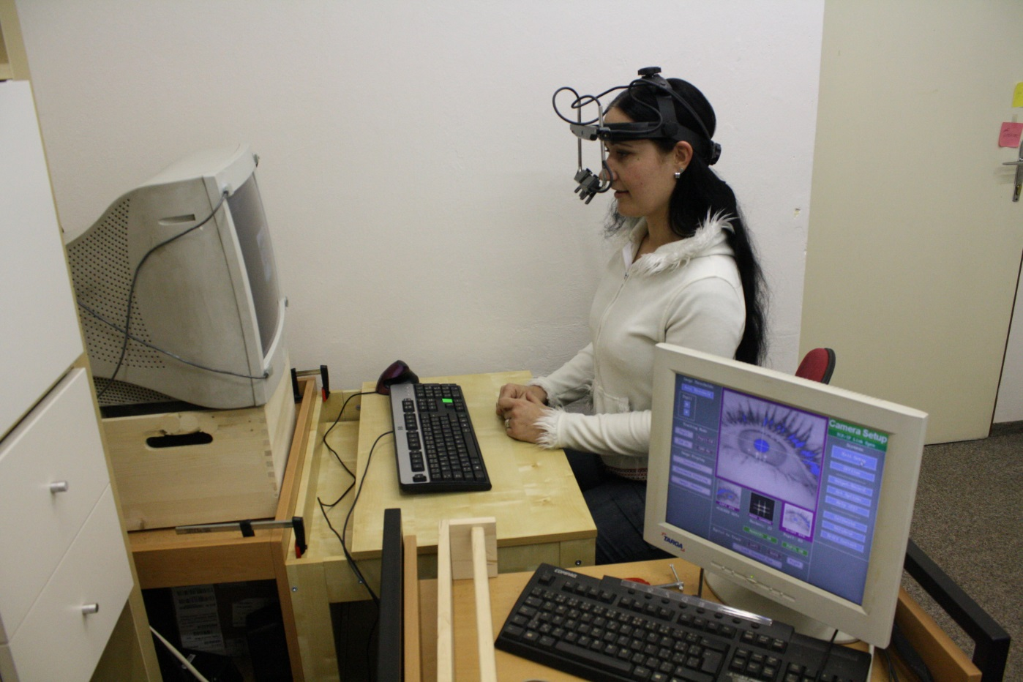
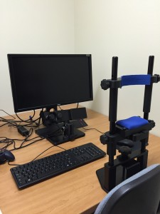
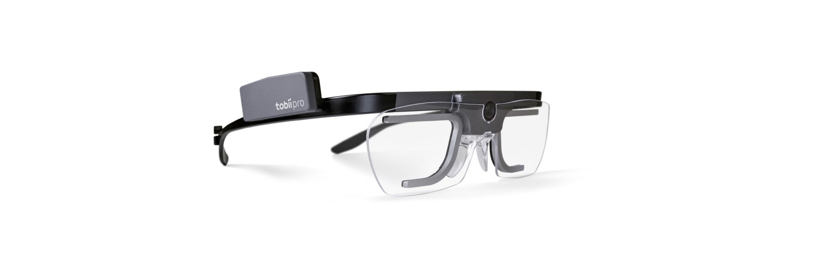
Video based eye-trackers
500 Hz
1000 Hz
120 Hz

Slide 16
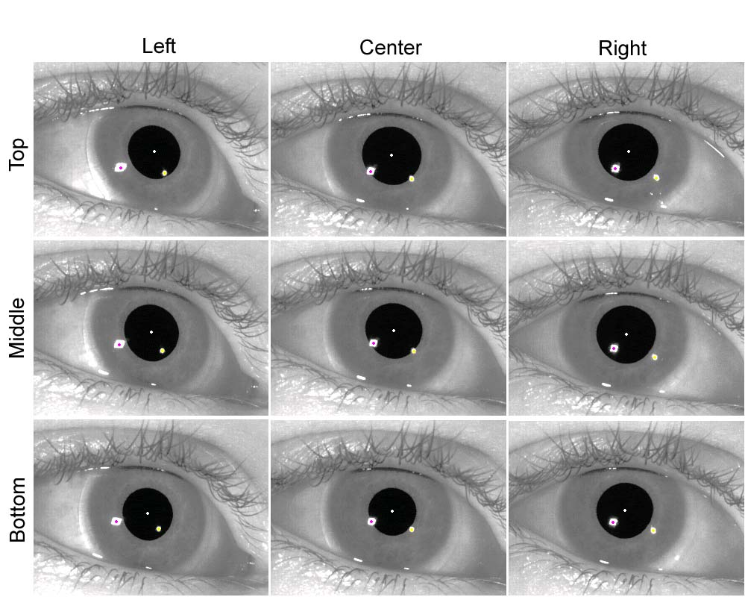
Video-based eye trackers
Using corneal reflection and IR light source
Desktop vs mobile eye tracking

Slide 17
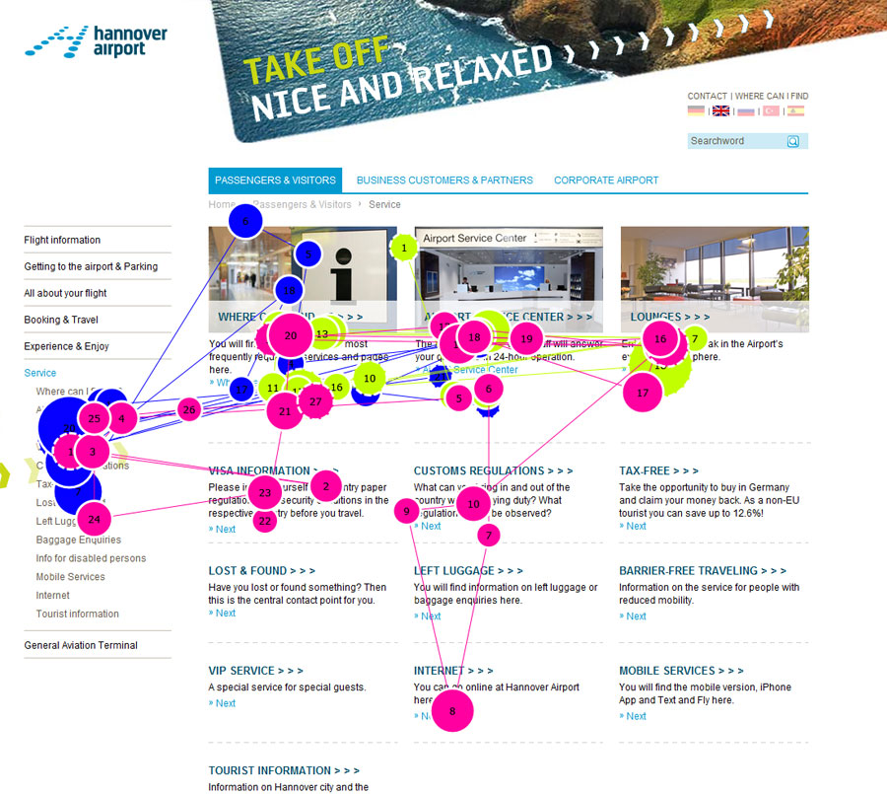
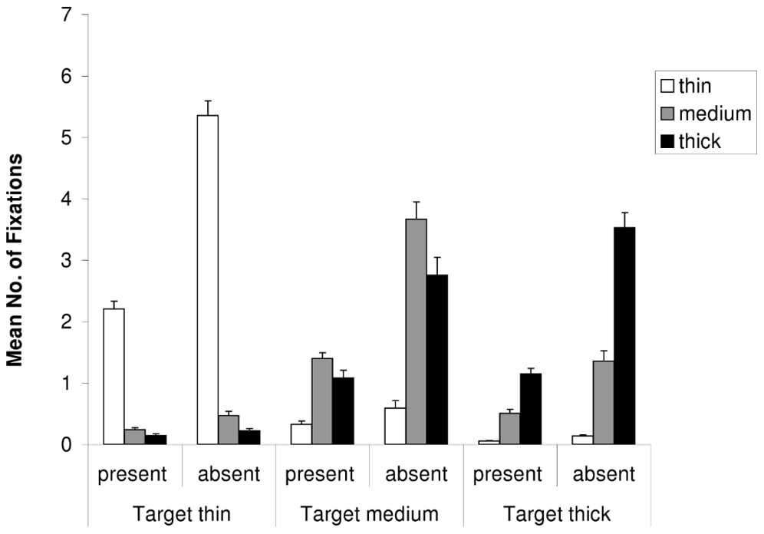
Type of analyses
Dwell times/Number of fixations
Scanpaths

Slide 18
Simple statistics
Compare eye movement descriptive statistics per each condition
number of fixations, duration of fixation, saccade length, saccade amplitude
Usually accompanied with AOI analysis
We can sum all fixations in each AOI to get a dwell time
Temporal order of fixations is not important

Slide 19

Simple statistics analysis example

Slide 20

Simple statistics analysis example
Define AOIs
Red – GUI parts
Blue – flower
Green – dynamic items

Slide 21
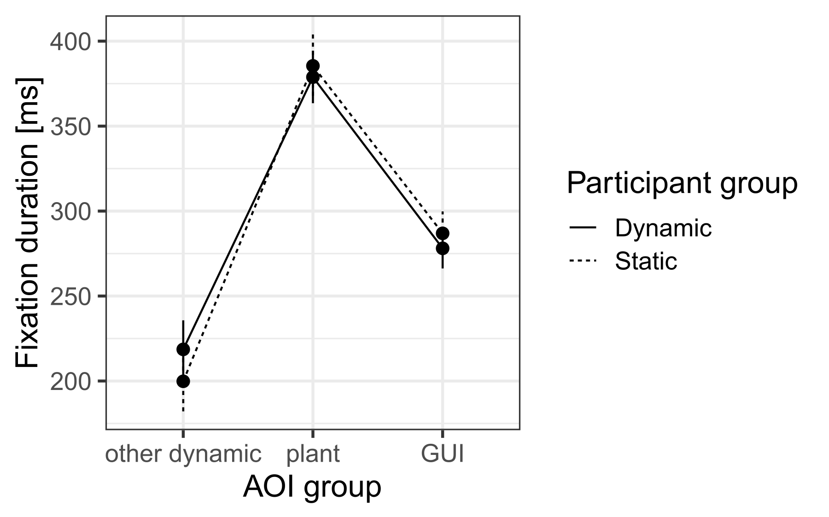
Simple statistics analysis example

Slide 22
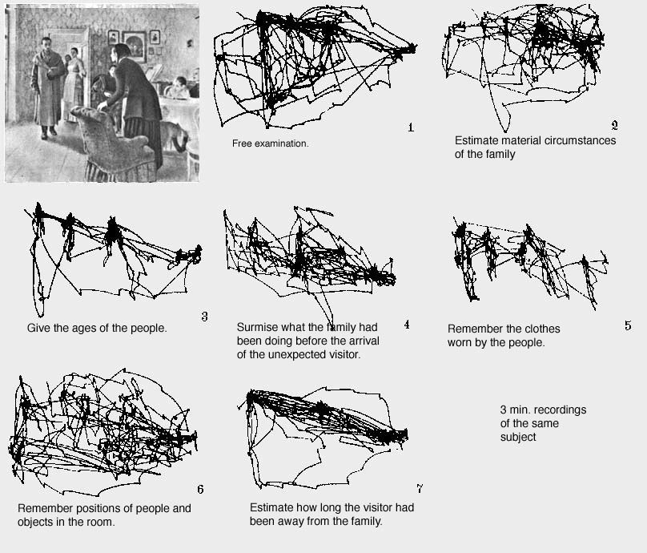
Scan paths
From Yarbus (1967) and Noton & Stark (1971)
Temporal order of fixation is also of interest

Slide 23
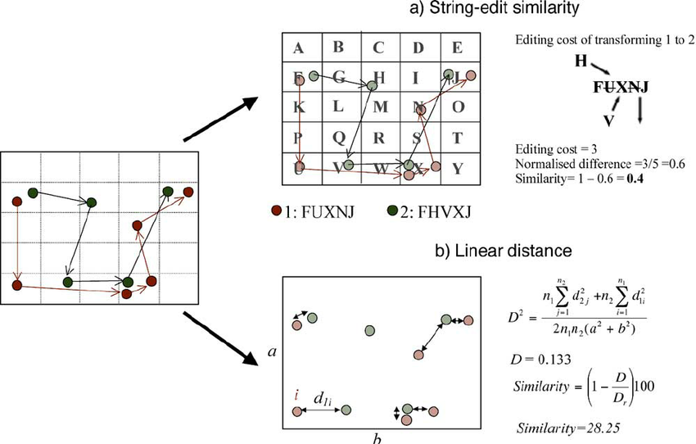
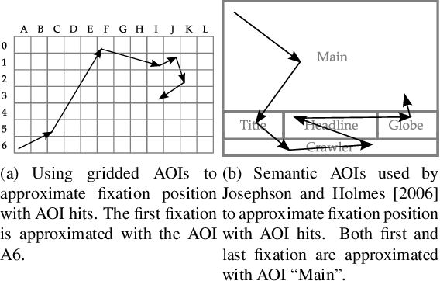
Methods for analyzing scanpaths
String distance metrics
Levenshtein distance
divide screen into regions and code each with letter

Slide 24
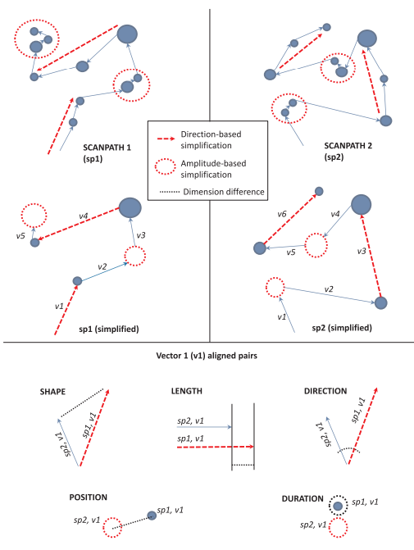
Methods for analyzing scanpaths
Multimatch
Complex approach to measuring similarity

Slide 25
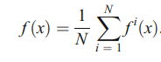
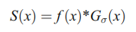
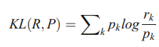
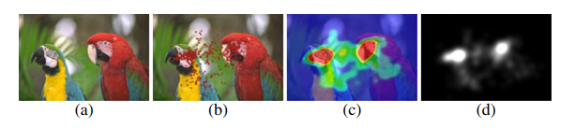
Methods for analyzing scanpaths
Saliency-based metrics
Seet of points is convolved with Gaussian
Kullback-Leibler divergence

Slide 26

Scanpath analysis example
Multiple Object tracking task

Slide 27
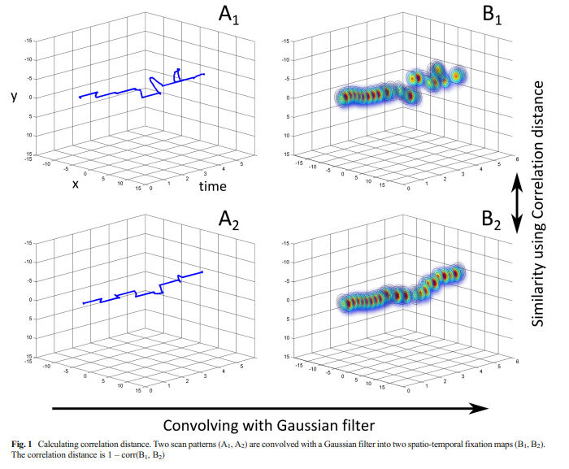
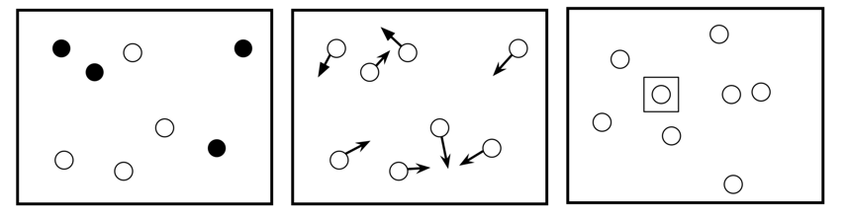
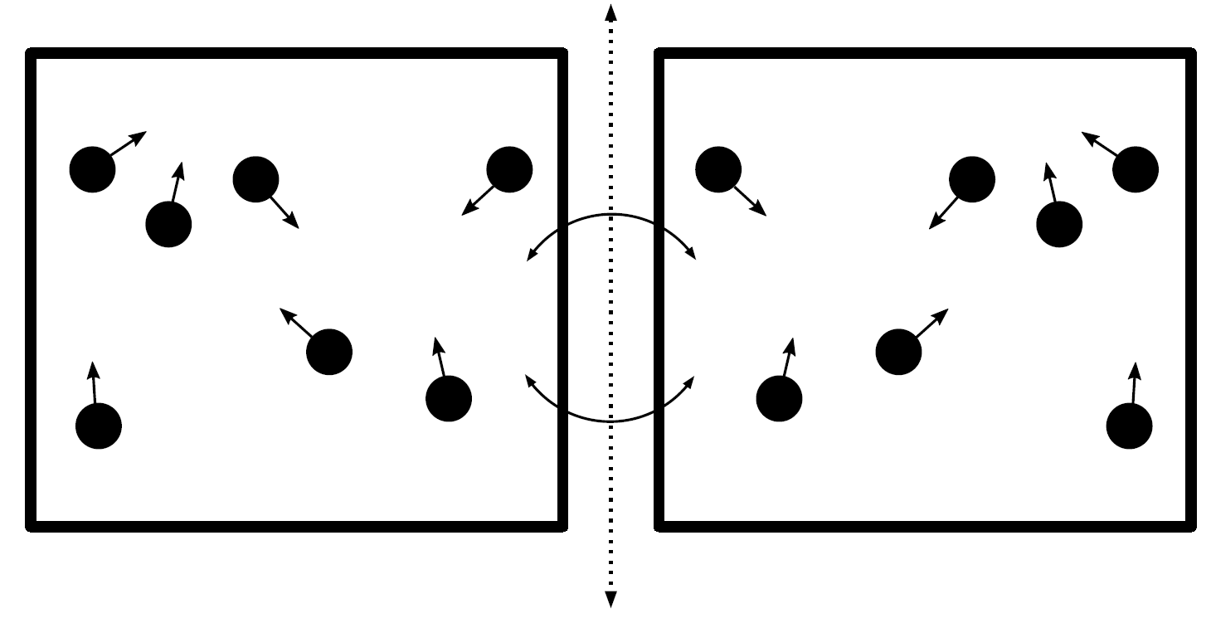
Scanpath analysis example - Methods

Slide 28
Scanpath analysis example - Results

Slide 29
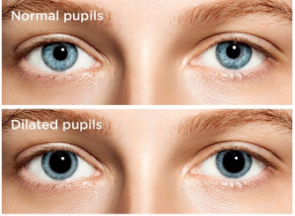
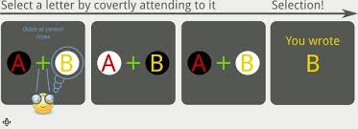
Pupilometry
Eye trackers measure size of the pupil
Eyes dilatate, when exposed to dark
Also can be used as a marker of emotional response, hunger, sleepness…

Slide 30
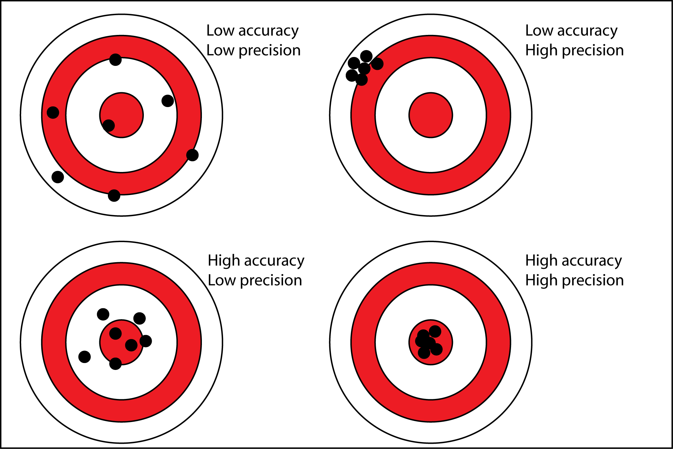
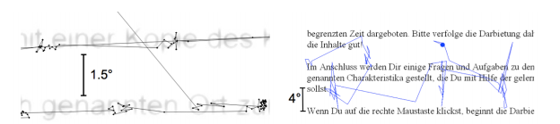
Accuracy and precision
Eye data quality

Slide 31
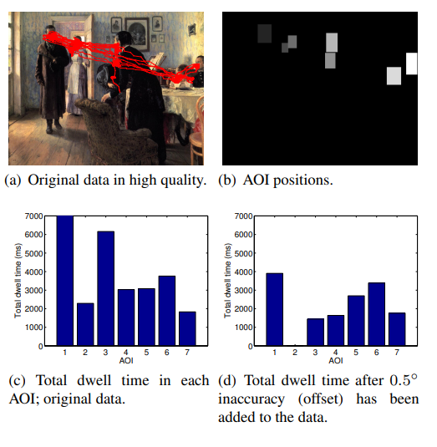
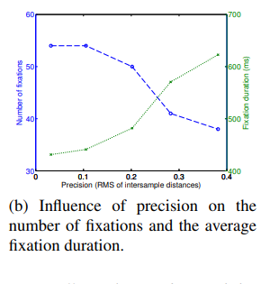
Accuracy and precision

Slide 32
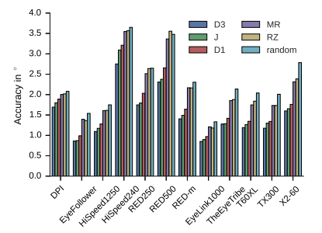
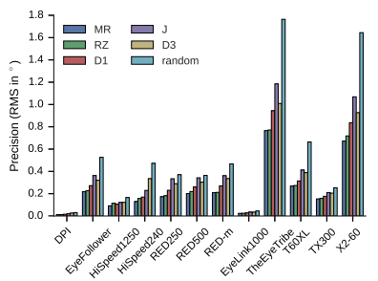
What influence data quality?
Participants
Operators
Task
Recording environment
Geometry of the experimental setup

Slide 33
Typical workflow
Code task in appropriate software (Octave + Psychtoolbox)
Welcome participant ☺
Calibrate eye-tracker
Validate eye tracker
Measure the experiment
Load data from eye-tracker
Preprocess data (remove blinks, compute fixations, …)
Perform final analysis

Slide 34
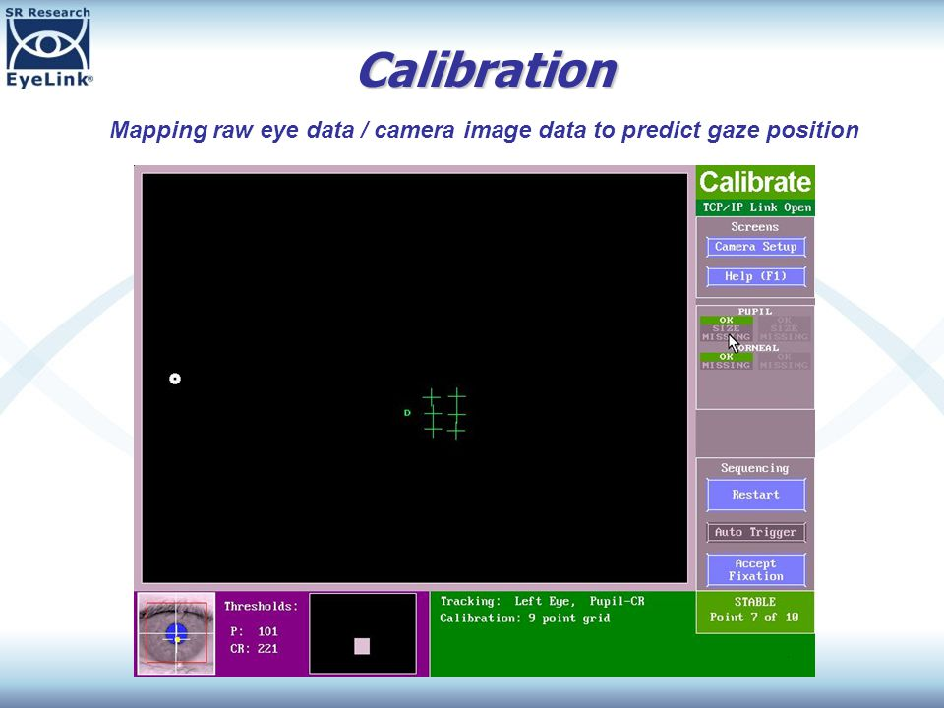
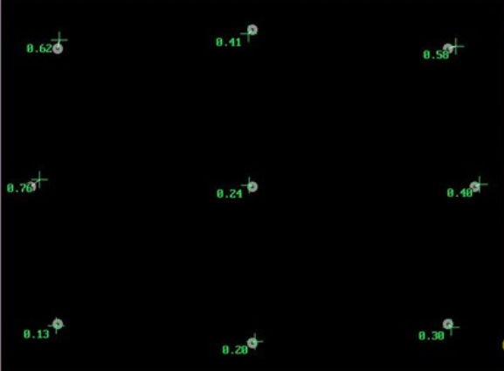
Calibration and validation
First step before actual measurement

Slide 35
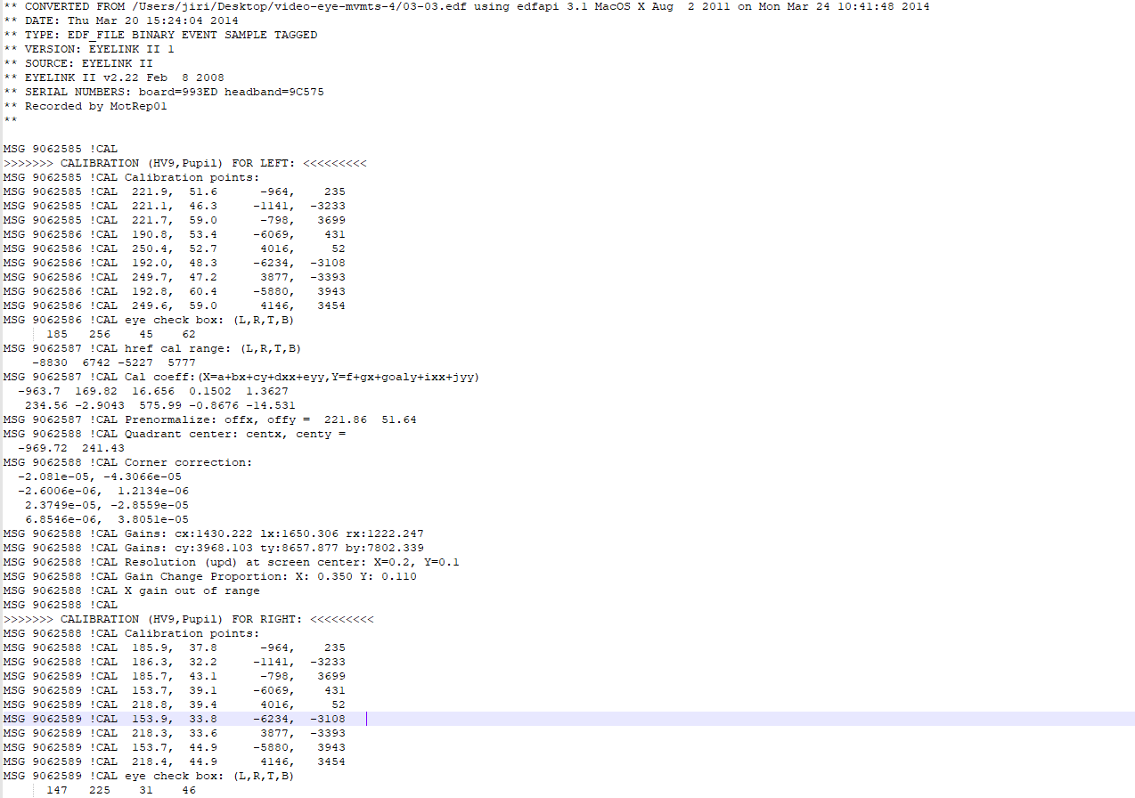
Example of raw data

Slide 36
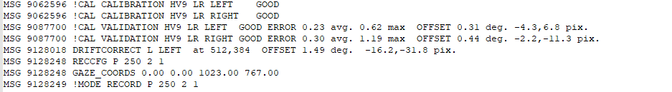
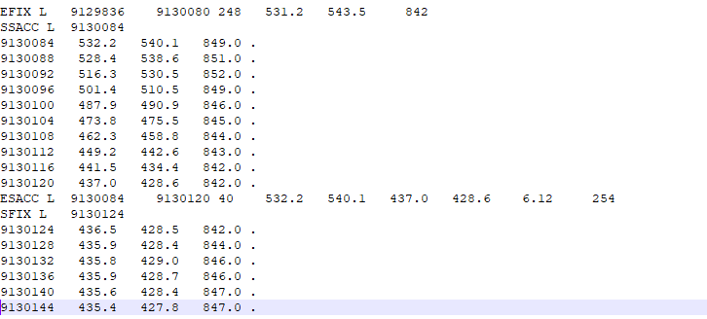
Example of raw data

Slide 37
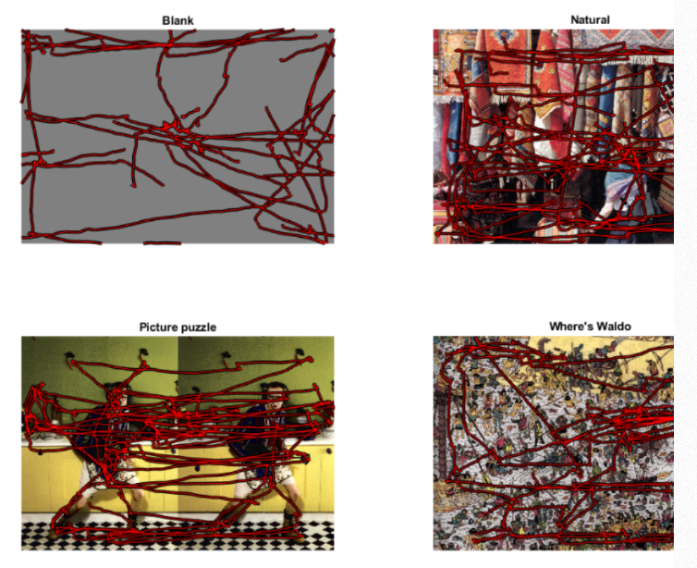
ETRA Challenge
ETRA – Eye tracking research and applications
4 tasks

Slide 38
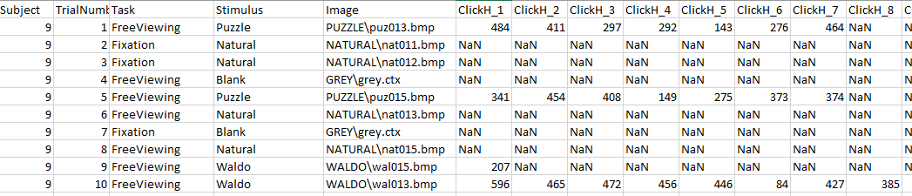
Data description
8 subjects
Data format
Subject identifier.
Task (Fixation or free viewing).
Visual scene type (Blank, Natural, Picture puzzle, Where's Waldo).
Visual scene image file.
45 s of binocular ere movement data.
For Picture puzzle and where's Waldo trials the locations of the clicks where subjects indicated differences or Waldo characters.

Slide 39
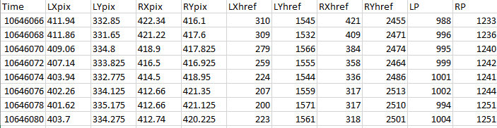
Individual recordings
Puzzle
L – left, R – right; Ignore*href columns; LP/RP pupil size

Slide 40
Your task
Load data (R/python/Jamovi)
You can use readxl package to load data in R
Test some hypotheses (1-2 based on the complexity) that you find interesting (for example):
Do eye movement behavior change when participants were free viewing the blank screen or when viewing natural images?
Is number of fixations in each stimuli consistent between participants?
Do pupil size change, when difference in puzzle is found? Or when Waldo is found?
Can we predict task based on the data pattern (machine learning)?
Write report 2 A4 long including data description, hypotheses and results
Consult your hypotheses with me before the task

Slide 41
Statistical crash course
You will need to test differences between conditions
When testing differences (differences in means)
Studied items in each group are different
between two groups -> independent t-tests
Between three and more groups -> anovas
Studied items in each group are the same (each participant is measured multiple times)
Two conditions -> paired t-tests
Three or more conditions -> anovas

Slide 42
P-value
Each test compute different test statistic
We have one common language, how to interpret the results
P-value – probability of obtain such difference in a case, when in reality are there no differences
Frequentist approach – set threshold on 0.05, 0.01 or 0.001 and compare observed p-value with this threshold

Slide 43
Hypotheses testing
State null hypothesis (“boring state of the world”)
State alternative hypothesis (“What you actually want to test”)
Run appropriate test and obtain p-value
If p-value is significant (lower than threshold), we reject null hypothesis and accept the alternative
If p-value is not-significant, we know nothing! We can’t accept null!!

Slide 44

Example data

Slide 45

T-tests in R
Version: static vs dynamic
And we could report findings as “We found significant differences in fixation duration between static and dynamic version (t(38184) = 2.19, p = 0.029)”

Slide 46


ANOVAs in R
Fixations for each participant could be divided into three AOI groups
And we could report: “Differences in fixation duration were significant between AOI groups (F(2,234) = 388.0, p < 0.001)

Slide 47

ANOVAs in R
We can test differences between version using ANOVA as well
ANOVA averages per participant by default

Slide 48


Simple manipulation with data
R changed a lot in past years
Tidyverse was a game changer, it uses pipe operator “%>%”, which works just like unix pipe “|”
Several primitives, that can be combined
select – select columns
filter – filter rows
group_by - groups data by variable
summarize – summarizes data in each group by given function

Slide 49


Plots
Use ggplot2 package, which builds the plot by adding layers

